Slide 1
Session 1:
Introduction to the Management of
Information Security
If this is the information superhighway, it’s
going through a lot of bad, bad neighborhoods.
-- DORIAN BERGER, 1997

Slide 2
Learning Objectives
Upon completion of this chapter, you should be able to:
  Recognize the importance of information technology and understand who is responsible for protecting an organization’s information assets
  Know and understand the definition and key characteristics of information security
  Know and understand the definition and key characteristics of leadership and management
  Recognize the characteristics that differentiate information security management from general management
Notes:
Learning Objectives
Upon completion of this chapter you should be able to:
Recognize the importance of information technology and understand who is responsible for protecting an organization’s information assets
Know and understand the definition and key characteristics of information security
Know and understand the definition and key characteristics of leadership and management
Recognize the characteristics that differentiate information security management from general management

Slide 3
Introduction
Information technology is critical to business and society
Computer security is evolving into information security
Information security is the responsibility of every member of an organization, but managers play a critical role
Notes:
Introduction
Information technology is the vehicle that stores and transports information from one business unit to another. But what happens if the vehicle breaks down, even for a little while?
As businesses have become more fluid, the concept of computer security has been replaced by the concept of information security.
Because this new concept covers a broader range of issues, from the protection of data to the protection of human resources, information security is no longer the sole responsibility of a discrete group of people in the company; rather, it is the responsibility of every employee, and especially managers.

Slide 4
Introduction
Information security involves three distinct communities of interest:
  Information security managers and professionals
  Information technology managers and professionals
  Non-technical business managers and professionals
Notes:
Introduction
Organizations must realize that information security decisions should involve three distinct groups of decision makers, or communities of interest:
Information security managers and professionals
Information technology managers and professionals
Non-technical business managers and professionals
Organizations must realize that information security decisions should involve three distinct groups of decision makers, or communities of interest:
Information security managers and professionals
Information technology managers and professionals
Non-technical business managers and professionals

Slide 5
Communities of Interest
InfoSec community: protect information assets from threats
IT community: support business objectives by supplying appropriate information technology
Business community: policy and resources
Notes:
Communities of Interest
InfoSec community: protects the organization’s information assets from the threats they face.
IT community: supports the business objectives of the organization by supplying and supporting information technology appropriate to the business’ needs.
Non-technical general business community: articulates and communicates organizational policy and objectives and allocates resources to the other groups.

Slide 6
What Is Security?
“The quality or state of being secure—to be free from danger”
Security is achieved using several strategies simultaneously
Notes:
What Is Security?
Understanding the technical aspects of information security requires that you know the definitions of certain information technology terms and concepts.
In general, security is defined as “the quality or state of being secure—to be free from danger.”
Security is often achieved by means of several strategies usually undertaken simultaneously or used in combination with one another.

Slide 7
Specialized Areas of Security
Physical security
Personal security
Operations security
Communications security
Network security
Information Security (InfoSec)
Computer Security
Notes:
Specialized areas of security
Physical security
Personal security
Operations security
Communications security
Network security
Information Security
Computer Security

Slide 8
Information Security
InfoSec includes information security management, computer security, data security, and network security
Policy is central to all information security efforts
Notes:
Information Security
Information security includes the broad areas of information security management, computer and data security, and network security.
At the heart of the study of information security is the concept of policy.
Policy, awareness, training, education, and technology are vital concepts for the protection of information and for keeping information systems from danger.

Slide 9
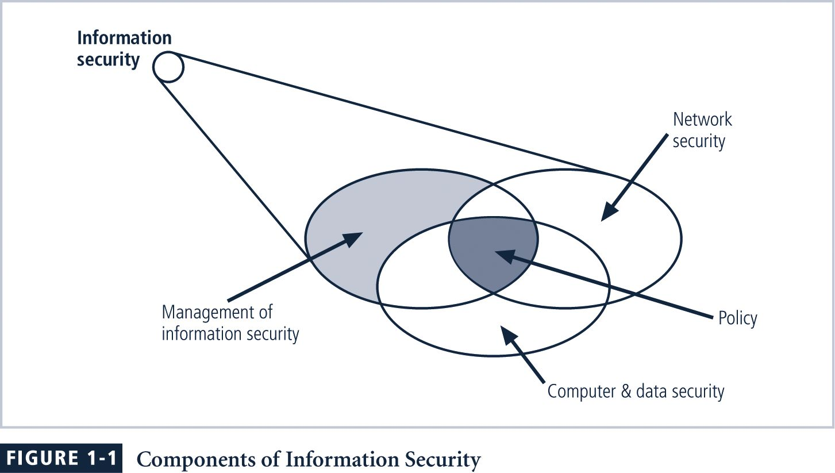
FIGURE 1-1
Components of Information Security
Notes:
FIGURE 1-1 Components of Information Security
Information security (InfoSec) is the protection of information and its critical elements, including the systems and hardware that use, store, and transmit that information.
Figure 1-1 shows that information security includes the broad areas of information security management (the topic of this book), computer and data security, and network security. At the heart of the study of information security is the concept of policy (discussed in detail in Chapter 4). Policy, awareness, training, education, and technology
are vital concepts for the protection of information and for keeping information systems from danger.

Slide 10
CIA Triangle
The C.I.A. triangle is made up of:
  Confidentiality
  Integrity
  Availability
Over time the list of characteristics has expanded, but these three remain central
Notes:
CIA Triangle
The C.I.A. triangle - confidentiality, integrity, and availability - has expanded into a more comprehensive list of critical characteristics of information.
The NSTISSC Security Model provides a more detailed perspective on security.
While the NSTISSC model covers the three dimensions of information security, it omits discussion of detailed guidelines and policies that direct the implementation of controls.
Another weakness of using this model with too limited an approach is to view it from a single perspective.

Slide 11
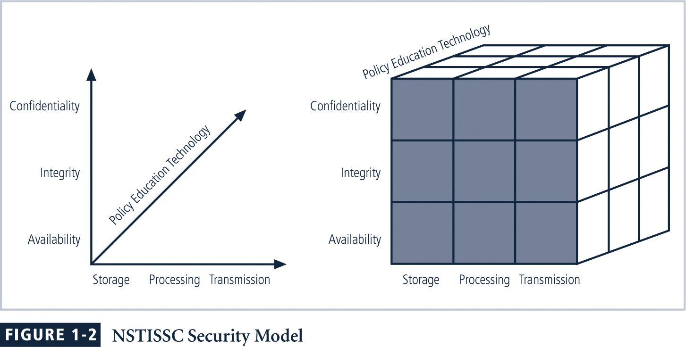
Figure 1-2 NSTISSC Security Model
Notes:
Figure 1-2 NSTISSC Security Model
The NSTISSC security model, as shown in Figure 1-2, illustrates three dimensions central to the discussion of information security. If we extend the relationship among the three dimensions represented by the axes, we end up with a 3 × 3 × 3 cube with 27 cells. Each of these cells represents an area of intersection among these three dimensions that must be addressed to secure information systems. When using this model to design or review any information security program, you must make sure that each of the 27 cells is properly addressed by each of the three communities of interest.

Slide 12
Key Concepts of Information Security
Identification
Identification
  Information systems possess the characteristic of identification when they are able to recognize individual users
  Identification and authentication are essential to establishing the level of access or authorization that an individual is granted
Notes:
Identification
An information system possesses the characteristic of identification when it is able to recognize individual users.
Identification and authentication are essential to establishing the level of access or authorization that an individual is granted.

Slide 13
Key Concepts of Information Security
Authentication
Authentication
  Authentication occurs when a control provides proof that a user possesses the identity that he or she claims
Notes:
Authentication
Authentication occurs when a control provides proof that a user possesses the identity that he or she claims.

Slide 14
Key Concepts of Information Security
Authorization
Authorization
  After the identity of a user is authenticated, a process called authorization provides assurance that the user (whether a person or a computer) has been specifically and explicitly authorized by the proper authority to access, update, or delete the contents of an information asset
Notes:
Authorization
After the identity of a user is authenticated, a process called authorization provides assurance that the user (whether a person or a computer) has been specifically and explicitly authorized by the proper authority to access, update, or delete the contents of an information asset.

Slide 15
Key Concepts of Information Security
Accountability
Accountability
  The characteristic of accountability exists when a control provides assurance that every activity undertaken can be attributed to a named person or automated process
Notes:
Accountability
The characteristic of accountability exists when a control provides assurance that every activity undertaken can be attributed to a named person or automated process.

Slide 16
Key Concepts of Information Security
Confidentiality
Confidentiality
  Confidentiality of information ensures that only those with sufficient privileges may access certain information
  To protect confidentiality of information, a number of measures may be used including:
    Information classification
    Secure document storage
    Application of general security policies
    Education of information custodians and end users
Notes:
Confidentiality
Confidentiality of information ensures that only those with sufficient privileges may access certain information.
To protect the confidentiality of information, a number of measures are used:
Information classification
Secure document storage
Application of general security policies
Education of information custodians and end users

Slide 17
Key Concepts of Information Security
Integrity
Integrity
  Integrity is the quality or state of being whole, complete, and uncorrupted
  The integrity of information is threatened when it is exposed to corruption, damage, destruction, or other disruption of its authentic state
  Corruption can occur while information is being compiled, stored, or transmitted
Notes:
Integrity
Integrity is the quality or state of being whole, complete, and uncorrupted.
The integrity of information is threatened when it is exposed to corruption, damage, destruction, or other disruption of its authentic state.
Corruption can occur while information is being compiled, stored, or transmitted.

Slide 18
Key Concepts of Information Security
Availability
Availability
  Availability is making information accessible to user access without interference or obstruction in the required format
  A user in this definition may be either a person or another computer system
  Availability means availability to authorized users
Notes:
Availability
Availability is the characteristic of information that enables user access to information without interference or obstruction and in a required format.
A user in this definition may be either a person or another computer system.
Availability does not imply that the information is accessible to any user; rather, it means availability to authorized users.

Slide 19
Key Concepts of Information Security
Privacy
Privacy
  Information is to be used only for purposes known to the data owner
  This does not focus on freedom from observation, but rather that information will be used only in ways known to the owner
Notes:
Privacy
The information that is collected, used, and stored by an organization is to be used only for the purposes stated to the data owner at the time it was collected.
This definition of privacy does focus on freedom from observation, but rather means that information will be used only in ways known to the person providing it.

Slide 20
What Is Management?
A process of achieving objectives using a given set of resources
To manage the information security process, first understand core principles of management
A manager is “someone who works with and through other people by coordinating their work activities in order to accomplish organizational goals”
Notes:
What Is Management?
Management is the process of achieving objectives using a given set of resources.
To make the information security process more effective, it is important to understand certain core principles of management.
A manager is “someone who works with and through other people by coordinating their work activities in order to accomplish organizational goals.”

Slide 21
Managerial Roles
Informational role: Collecting, processing, and using information to achieve the objective
Interpersonal role: Interacting with superiors, subordinates, outside stakeholders, and other
Decisional role: Selecting from alternative approaches and resolving conflicts, dilemmas, or challenges
Notes:
Management
Managerial roles:
Informational role: Collecting, processing, and using information that can affect the completion of the objective
Interpersonal role: Interacting with superiors, subordinates, outside stakeholders, and other parties that influence or are influenced by the completion of the task
Decisional role: Selecting from among alternative approaches, and resolving conflicts, dilemmas, or challenges.

Slide 22
Differences Between Leadership and Management
The leader influences employees so that they are willing to accomplish objectives
He or she is expected to lead by example and demonstrate personal traits that instill a desire in others to follow
Leadership provides purpose, direction, and motivation to those that follow
A manager administers the resources of the organization
Notes:
The Difference Between Leadership and Management
The distinction between a leader and a manager arises in the execution of organizational tasks.
The leader influences employees so that they are willing to accomplish objectives.
He or she is expected to lead by example and demonstrate personal traits that instill a desire in others to follow.
In other words, leadership provides purpose, direction, and motivation to those that follow.
By comparison, a manager administers the resources of the organization.

Slide 23
Characteristics of a Leader
Bearing
Courage
Decisiveness
Dependability
Endurance
Enthusiasm
Initiative
Integrity
Judgment
Justice
Knowledge
Loyalty
Tact
Unselfishness
Notes:
Characteristics of a Leader
What makes a good leader?
Bearing
Courage
Decisiveness
Dependability
Endurance
Enthusiasm
Initiative
Integrity
Judgment
Justice
Knowledge
Loyalty
Tact
Unselfishness

Slide 24
What Makes a Good Leader?
Action plan for improvement of leadership abilities
  Know yourself and seek self-improvement
  Be technically and tactically proficient
  Seek responsibility and take responsibility for your actions
  Make sound and timely decisions
  Set the example
  Know your [subordinates] and look out for their well-being
Notes:
Action plan for improvement of leadership abilities:
Know yourself and seek self-improvement.
Be technically and tactically proficient.
Seek responsibility and take responsibility for your actions.
Make sound and timely decisions.
Set the example.
Know your [subordinates] and look out for their well-being.
Keep your subordinates informed.
Develop a sense of responsibility in your subordinates.
Ensure the task is understood, supervised, and accomplished.
Build the team.
Employ your [team] in accordance with its capabilities.

Slide 25
What Makes a Good Leader? (Continued)
Action plan for improvement of leadership abilities
  Keep your subordinates informed
  Develop a sense of responsibility in your subordinates
  Ensure the task is understood, supervised, and accomplished
  Build the team
  Employ your team in accordance with its capabilities
Notes:
Action plan for improvement of leadership abilities:
Know yourself and seek self-improvement.
Be technically and tactically proficient.
Seek responsibility and take responsibility for your actions.
Make sound and timely decisions.
Set the example.
Know your [subordinates] and look out for their well-being.
Keep your subordinates informed.
Develop a sense of responsibility in your subordinates.
Ensure the task is understood, supervised, and accomplished.
Build the team.
Employ your [team] in accordance with its capabilities.

Slide 26
Be…Know…Do…
A leader must:
  BE a person of strong and honorable character
  KNOW you, the details of your situation, the standards to which you work, human nature, and your team
  DO by providing purpose, direction, and motivation to your team
Notes:
Be…Know…Do…
As a leader you must BE a person of strong and honorable character; committed to professional ethics; an example of individual values; and able to resolve complex ethical dilemmas.
You must KNOW the details of your situation, the standards to which you work, yourself, human nature, and your team.
You must DO by providing purpose, direction, and motivation to your teams.

Slide 27
Characteristics of Management
Two well-known approaches to management:
  Traditional management theory using principles of planning, organizing, staffing, directing, and controlling (POSDC)
  Popular management theory using principles of management into planning, organizing, leading, and controlling (POLC)
Notes:
Characteristics of Management
Two basic approaches to management exist:
Traditional management theory uses the core principles of planning, organizing, staffing, directing, and controlling (POSDC).
Popular management theory categorizes the principles of management into planning, organizing, leading, and controlling (POLC).

Slide 28
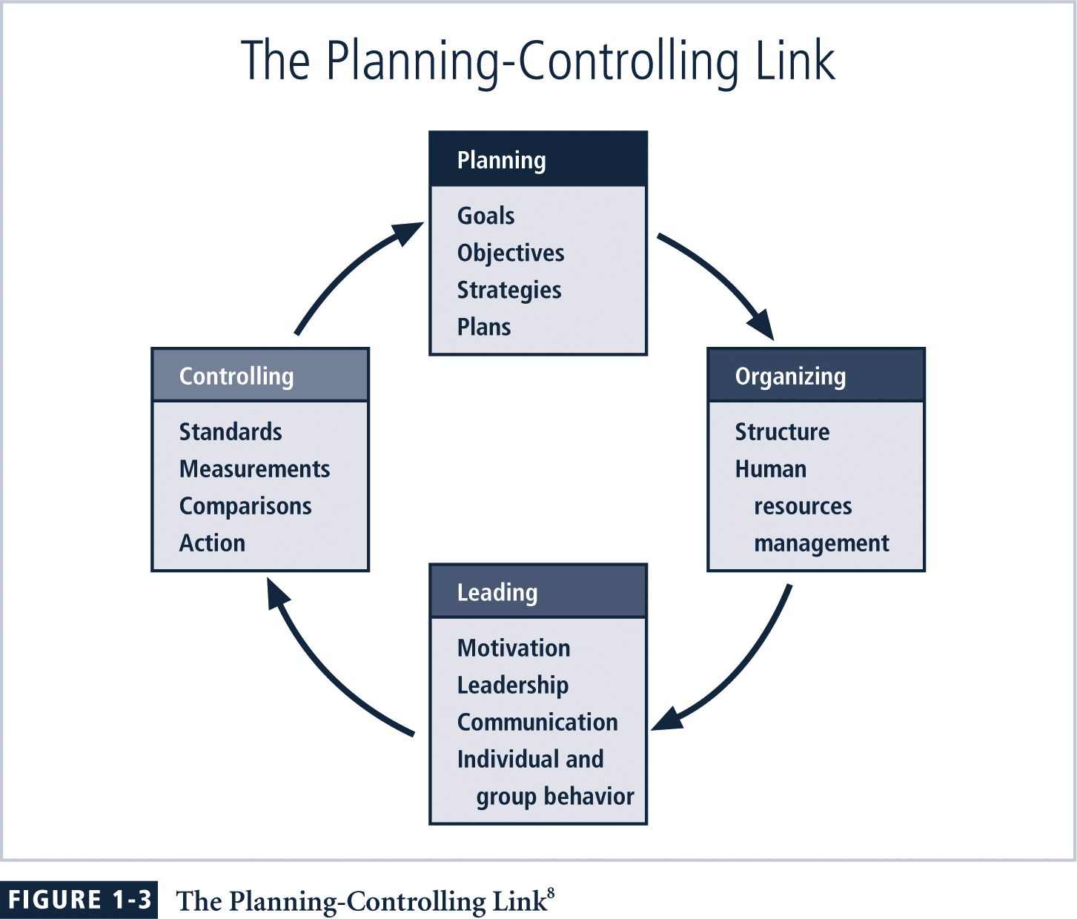
Figure 1-3
The Planning–Controlling Link
Notes:
Figure 1-3 The Planning–Controlling Link
The management of tasks leading to the accomplishment of any objective requires certain basic skills. These skills are referred to as management characteristics, functions, principles, or responsibilities. Two basic approaches to management exist:
■ Traditional management theory uses the core principles of planning, organizing, staffing, directing, and controlling (POSDC).
■ Popular management theory categorizes the principles of management into planning, organizing, leading, and controlling (POLC).
The text uses POLC to examine the skills that managers must employ when dealing with tasks. Figure 1-3 shows an overview of these elements and illustrates how the elements are conceptually related.

Slide 29
Planning
Planning: process that develops, creates, and implements strategies for the accomplishment of objectives
Three levels of planning:
  Strategic
  Tactical
  Operational
Notes:
Planning
The process that develops, creates, and implements strategies for the accomplishment of objectives.
There are three levels of planning:
Strategic
Tactical
Operational

Slide 30
Planning (Continued)
In general, planning begins with the strategic plan for the whole organization
  To do this successfully, organization must thoroughly define its goals and objectives
Notes:
Planning
The general approach to planning begins with the creation of strategic plans for the entire organization.
To better understand the planning process, an organization must thoroughly define its goals and objectives.

Slide 31
Organization
Organization: structuring of resources to support the accomplishment of objectives
Organizing tasks requires determining:
  What is to be done
  In what order
  By whom
  By which methods
  When
Notes:
Organization
The principle of management dedicated to the structuring of resources to support the accomplishment of objectives.
Organizing tasks requires determining what is to be done, in what order, by whom, by which methods, and according to what timeline.

Slide 32
Leadership
Encourages the implementation of the planning and organizing functions, including supervising employee behavior, performance, attendance, and attitude
Leadership generally addresses the direction and motivation of the human resource
Notes:
Leadership
As noted earlier, leadership encourages the implementation of the planning and organizing functions. It includes supervising employee behavior, performance, attendance, and attitude.
Leadership generally addresses the direction and motivation of the human resource.

Slide 33
Control
Control:
  Monitoring progress toward completion
  Making necessary adjustments to achieve the desired objectives
Controlling function determines what must be monitored as well using specific control tools to gather and evaluate information
Notes:
Control
Monitoring progress toward completion, and making necessary adjustments to achieve the desired objectives, requires the exercise of control.
In general, the control function serves to assure the organization of the validity of the plan.
The controlling function also determines what must be monitored as well as applies specific control tools to gather and evaluate information.

Slide 34
Control Tools
Four categories:
  Information
  Financial
  Operational
  Behavioral
Notes:
Control Tools
There are four categories of control tools:
Information control tools.
Financial control tools.
Operational control tools.
Behavioral control tools

Slide 35
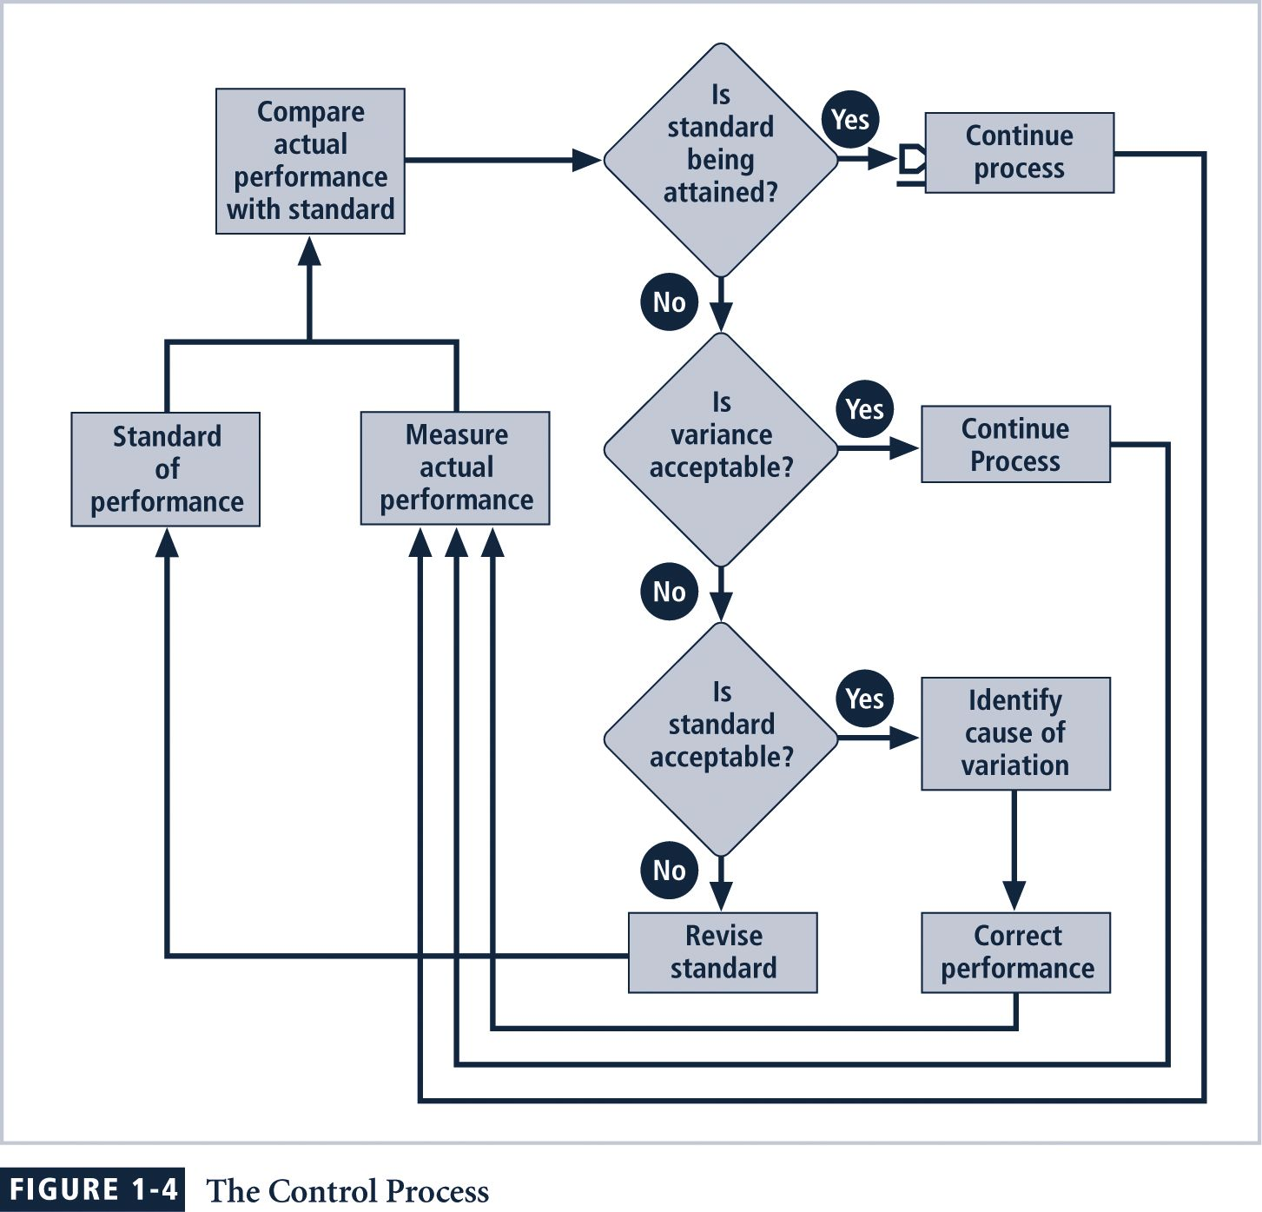
Figure 1-4
The Control Process
Notes:
Figure 1-4 The Control Process
Each of the management behavior tool categories relies on the use of negative feedback. They all use performance measurements, comparison, and corrective action, an approach that is illustrated as a control process in Figure 1-4.

Slide 36
Solving Problems
Step 1: Recognize and Define the Problem
Step 2: Gather Facts and Make Assumptions
Step 3: Develop Possible Solutions
Step 4: Analyze and Compare the Possible Solutions
Step 5: Select, Implement, and Evaluate a Solution
Notes:
Solving Problems
Step 1: Recognize and Define the Problem
Step 2: Gather Facts and Make Assumptions
Step 3: Develop Possible Solutions
Step 4: Analyze and Compare the Possible Solutions
Step 5: Select, Implement, and Evaluate a Solution

Slide 37
Feasibility Analyses
Economic feasibility assesses costs and benefits of a solution
Technological feasibility assesses an organization’s ability to acquire and manage a solution
Behavioral feasibility assesses whether members of the organization will support a solution
Operational feasibility assesses if an organization can integrate a solution
Notes:
Feasibility Analyses:
Economic feasibility: the costs and benefits of possible solutions.
Technological feasibility: the organization’s ability to acquire the technology needed to implement a candidate solution.
Behavioral feasibility: the likelihood that subordinates will adopt and support a solution, rather than resisting it.
Operational feasibility: the organization’s ability to integrate a candidate solution into its current business processes.

Slide 38
Principles Of Information Security Management
The extended characteristics of information security are known as the six Ps:
  Planning
  Policy
  Programs
  Protection
  People
  Project Management
Notes:
Principles Of Information Security Management
The extended characteristics of information security are known as the six Ps.
Planning
Policy
Programs
Protection
People
Project Management

Slide 39
InfoSec Planning
Planning as part of InfoSec management is an extension of the basic planning model discussed earlier in this chapter
Included in the InfoSec planning model are activities necessary to support the design, creation, and implementation of information security strategies as they exist within the IT planning environment
Notes:
InfoSec Planning
Planning as part of InfoSec management is an extension of the basic planning model discussed earlier in this chapter.
Included in the InfoSec planning model are activities necessary to support the design, creation, and implementation of information security strategies, as they exist within the IT planning environment

Slide 40
InfoSec Planning Types
Several types of InfoSec plans exist:
  Incident response
  Business continuity
  Disaster recovery
  Policy
  Personnel
  Technology rollout
  Risk management and
  Security program including education, training and awareness
Notes:
InfoSec Planning
Several types of InfoSec plans exist:
incident response planning
business continuity planning
disaster recovery planning
policy planning
personnel planning
technology rollout planning
risk management planning and
security program planning including education, training and awareness.

Slide 41
Policy
Policy: set of organizational guidelines that dictates certain behavior within the organization
In InfoSec, there are three general categories of policy:
  General program policy (Enterprise Security Policy)
  An issue-specific security policy (ISSP)
  System-specific policies (SSSPs)
Notes:
Policy
The set of organizational guidelines that dictates certain behavior within the organization is called policy.
In InfoSec, there are three general categories of policy:
• General program policy (Enterprise Security Policy)
• An issue-specific security policy (ISSP)
• System-specific policies (SSSPs)

Slide 42
Programs
Programs: specific entities managed in the information security domain
A security education training and awareness (SETA) program is one such entity
Other programs that may emerge include a physical security program, complete with fire, physical access, gates, guards, and so on
Notes:
Programs
Specific entities managed in the information security domain.
A security education training and awareness (SETA) program is one such entity.
Other programs that may emerge include a physical security program, complete with fire, physical access, gates, guards, and so on.

Slide 43
Protection
Risk management activities, including risk assessment and control, as well as protection mechanisms, technologies, and tools
Each of these mechanisms represents some aspect of the management of specific controls in the overall information security plan
Notes:
Protection
The protection function is executed via a set of risk management activities, including risk assessment and control, as well as protection mechanisms, technologies, and tools.
Each of these mechanisms represents some aspect of the management of specific controls in the overall information security plan.

Slide 44
People
People are the most critical link in the information security program
It is imperative that managers continuously recognize the crucial role that people play
Including information security personnel and the security of personnel, as well as aspects of the SETA program
Notes:
People
People are the most critical link in the information security program. As discussed in the Viewpoint section, it is imperative that managers continuously recognize the crucial role that people play in the information security program.
This aspect of InfoSec includes security personnel and the security of personnel, as well as aspects of the SETA program mentioned earlier.

Slide 45
Project Management
Project management discipline should be present throughout all elements of the information security program
Involves
  Identifying and controlling the resources applied to the project
  Measuring progress and adjusting the process as progress is made toward the goal
Notes:
Project Management
The final component is the application of thorough project management discipline to all elements of the information security program.
This effort involves identifying and controlling the resources applied to the project, as well as measuring progress and adjusting the process as progress is made toward the goal.

Slide 46
Summary
What is Security?
What is Management?
Principles of Information Security Management
  Planning
  Policy
  Programs
  Protection
  People
  Project Management

